Slide 1
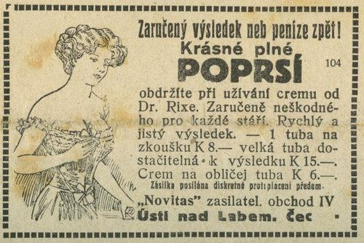
Topic 6: Advertising
Industrial Organisation / Matěj Bajgar

Slide 2
Introduction
2.1% of Czech GDP is accounted for by advertising expenditures account (similar in US)
Compare with
1.4% for defense
1.9% on R&D
3.5% on public education (elementary-university)
TV | 48%
Internet | 30%
Ads (Google ads, Facebook...) | 68%
Search | 29%
Other | 3%
Press | 13%
Radio | 6%
Outdoors | 3%
Notes:
In Czechia, advertising expenditures account to about 2.1% GDP (similar in the US)
Compare with 1.4% for defense and 1.9% on R&D and 3.5% on public education (elementary-university)
https://www.mediar.cz/investice-do-reklamy-loni-neklesly-dosahly-temer-120-miliard-kc/
https://www.itbiz.cz/zpravicky/v-roce-2020-dosahl-objem-online-reklamy-v-cr

Slide 3
Introduction
“Hardly any business practice causes economists greater uneasiness than advertising” Telser (1964)
Advertising makes economists uneasy. Why is that?
With most things, we know if they are good or bad
E.g. education is good, pollution is bad.
But how about advertising?
It goes more fundamental than that.
As economists, we assume preferences are fixed and study how well we are able to satisfy these fixed preferences.
But the point of advertising is to change people‘s preferences. Can we still study advertising?

Slide 4
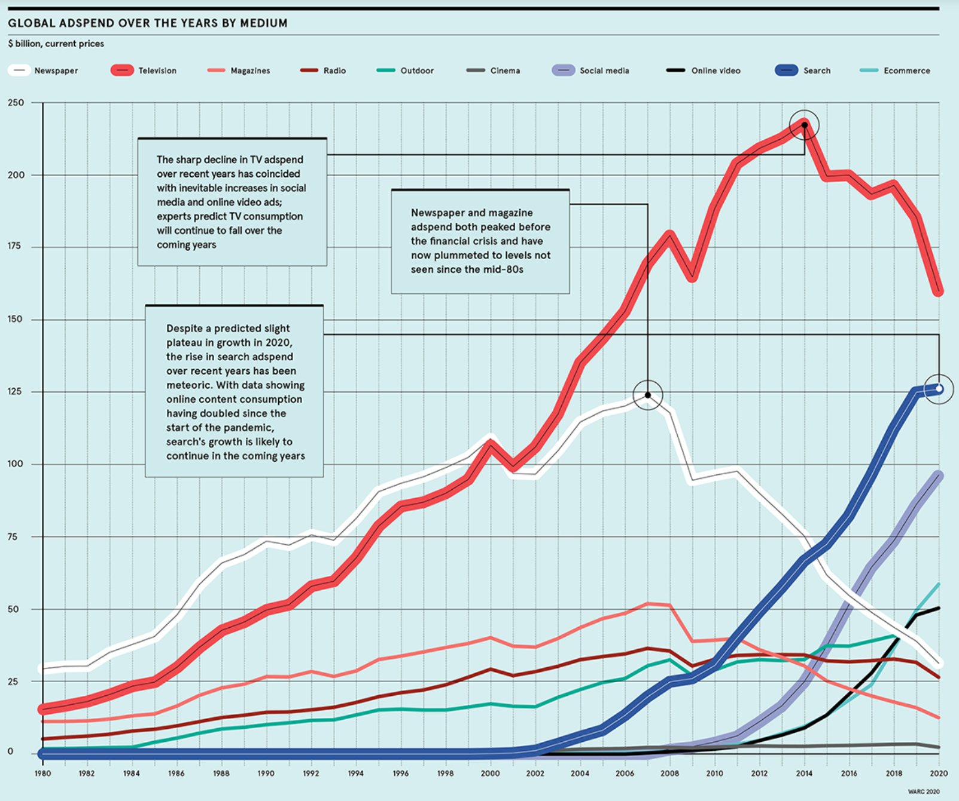
Why should I care?
Notes:
https://www.raconteur.net/infographics/ad-evolution/

Slide 5

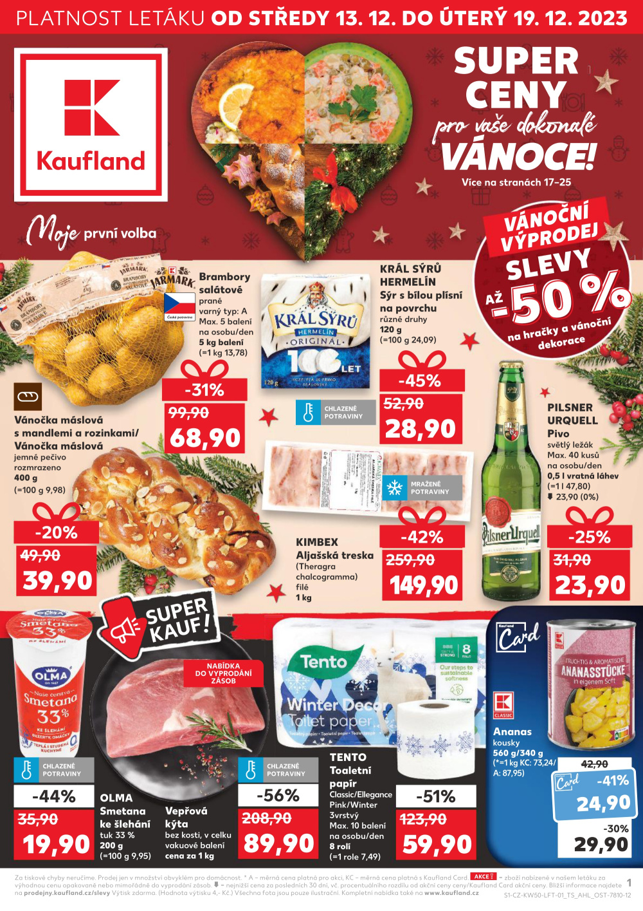
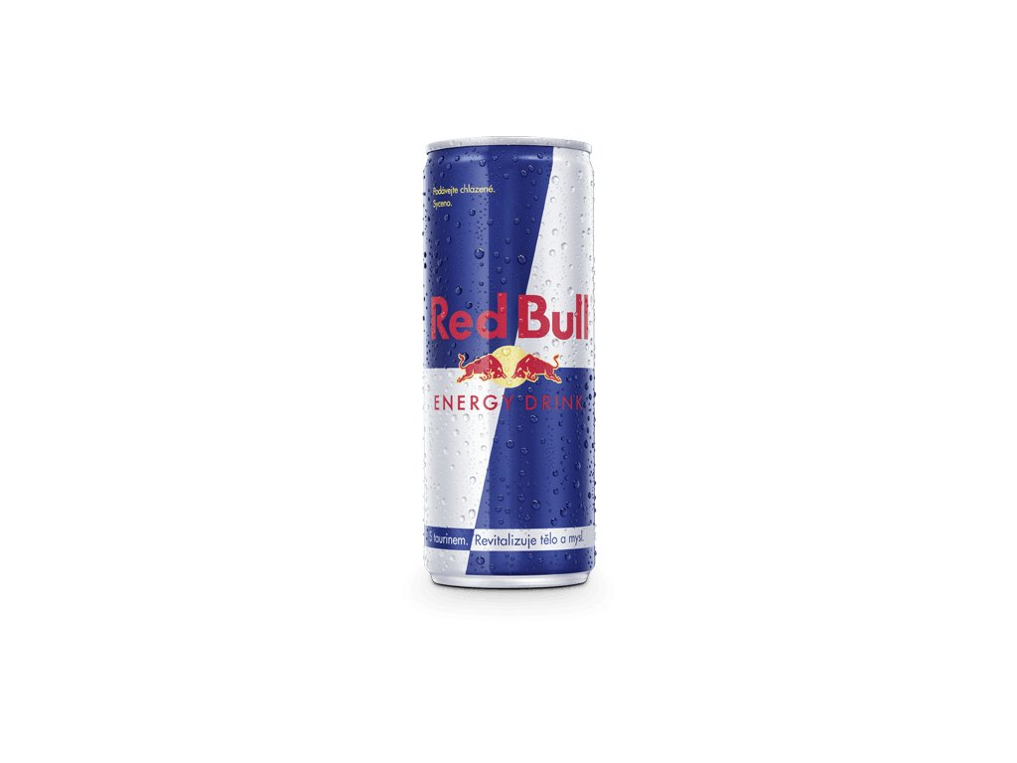
3 views of advertising
Yet another reason to be uneasy: 3 rather different ways to think about advertising
Persuasive – affects consumers tastes (i.e. change their preferences)
Informative – provides consumers with information about existence, price and characteristics of products
directly
indirectly, through signalling by the virtue of paying for an ad (independently of the content)
Complementary – advertising complementary to the product (we would not feel so cool owning a product if its ads did not make its ownership cool)
https://www.youtube.com/watch?v=NtZVFUvn3_U
All 3 views correct in certain contexts and no view correct in all contexts

Slide 6
Topic outline
Persuasive advertising
Direct informative advertising
Indirect informative advertising

Slide 7
Topic outline
Persuasive advertising
Direct informative advertising
Indirect informative advertising

Slide 8
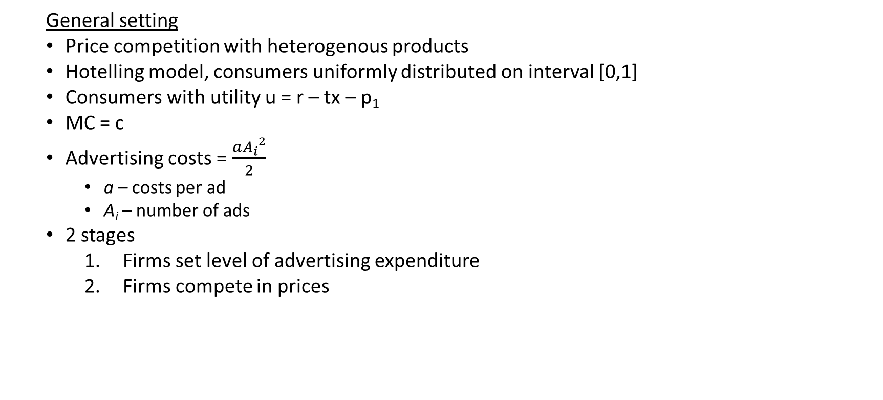
Persuasive advertising and competition
General setting
Price competition with heterogenous products
Hotelling model, consumers uniformly distributed on interval [0,1]
Consumers with utility u = r – tx – p₁
MC = c
Advertising costs = $\frac{a{A_{i}}^{2}}{2}$
a – costs per ad
A_{i} – number of ads
2 stages
Firms set level of advertising expenditure
Firms compete in prices

Slide 9
Persuasive advertising and competition
2 possible effects of persuasive advertising
Increase in willingness to pay, i.e. r = r(A)
Increase in perceived product differences, i.e. t = t(A)

Slide 10
Persuasive advertising and competition
Increase in willingness to pay
Assume u = r₁(A₁) – tx – p₁ = r + bA₁ – tx – p₁
Indifferent consumer:
r + bA₁ – tx* – p₁ = r + bA₂ – t(1-x*) – p₂
x* = 1/2 + (p₂-p₁)/2t + b(A₁-A₂)/(2t)
Stage 2 (for firm 1; for firm 2 symmetric)
max π₁ = (p₁ – c)[1/2 + (p₂-p₁)/2t + b(A₁-A₂)/(2t)]
FOC: p*₁ = (t+p₂+c+b(A₁-A₂))/2
Symmetric Nash equilibrium:
p₁(A₁,A₂) = c + t + b(A₁-A₂)/3
π₁(A₁,A₂) = (3t + b(A₁-A₂))²/(18t)

Slide 11
Persuasive advertising and competition
Increase in willingness to pay
Stage 1
Max π₁ (A₁,A₂) = (3t + b(A₁-A₂))²/(18t) – aA₁²/2
FOC: b(3t + b(A₁-A₂))/(9t) – aA₁ = 0
➔ A₁ = [b/(9at – b²)] (3t – bA₂)
➔ Increase in A₂ leads to a decrease in A₁ (i.e. A_{i}‘s are strategic substitutes)
Symmetric Nash equilibrium:
A₁* = A₂* = b / (3a)
p₁* = p₂* = c + t
π₁* = π₁* = t/2 – b²/(18a)
➔ Advertising does not affect equil. price because effects of A₁ and A₂ cancel out
➔ Profits reduced by advertising costs
Implication: If firms could, they would agree to do no advertising
Example: Professional associations often lobby for an advertising ban

Slide 12
Persuasive advertising and competition
Increase in perceived product differences
u = r – t(A₁,A₂)x – p₁ = r – (t+bA₁+bA₂)x – p₁
Stage 2 (for firm 1; for firm 2 symmetric)
Simply plug (t+bA₁+bA₂) for t in the standard model
Symmetric Nash equilibrium:
p₁(A₁,A₂) = c + t + bA₁ + bA₂
π₁(A₁,A₂) = (t+bA₁+bA₂)/2

Slide 13
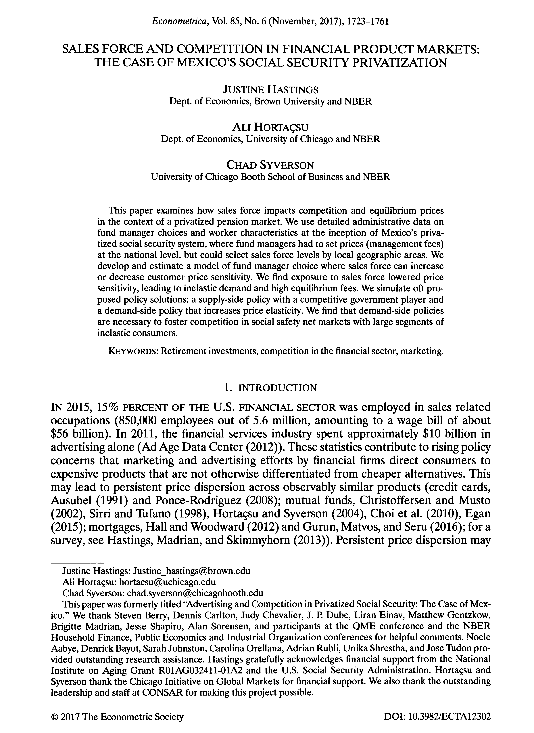
Persuasive advertising and competition
Increase in perceived product differences
Stage 1
Max π₁ (A₁,A₂) = (t+bA₁+bA₂)/2 – aA₁²/2
FOC: b/2 – aA₁ = 0
Symmetric Nash equilibrium:
A₁* = A₂* = b / (2a)
p₁* = p₂* = c + t + b²/a
π₁* = π₂* = t/2 + b²/(18a)
➔ If persuasive advertising increases perceived product differences, it gives firms more market power, higher prices and greater profits
Implication: Advertising a public good so if firms could, they would co-ordinate their advertising effort.

Slide 14
Exercise: Negative advertising
CocaCola (1) and Pepsi (2) compete in a Hotelling model on line [0,1], they both have zero marginal costs.
Consumers, unaware of how much sugar there is in the drinks, derive utilities 20 – 5x – p₁ and 20 – 5(1-x) – p₂ from drinking them.
If consumers knew how much sugar there is and what its health consequences are, their utility would drop by 10 (i.e. 10 – 5x – p₁ and 10 – 5(1-x) – p₂)
Derive the equilibrium if the firms cannot inform customers about the sugar content.
Suppose the firms can costlessly inform the public about the sugar content in their drink. Analyse the equilibrium in a 2-stage game where stage 1 involves decision about informing the customers and stage 2 is the Hotelling model.
Suppose firms can pay A to inform the public about the competitor‘s sugar content. How will the new equilibrium depend on the costs of the campaing A?
Are consumers better off with or without the information campaign?

Slide 15
Topic outline
Persuasive advertising
Direct informative advertising
Indirect informative advertising

Slide 16
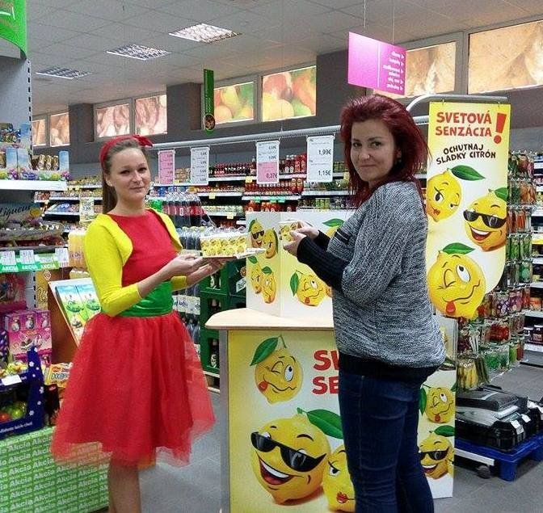
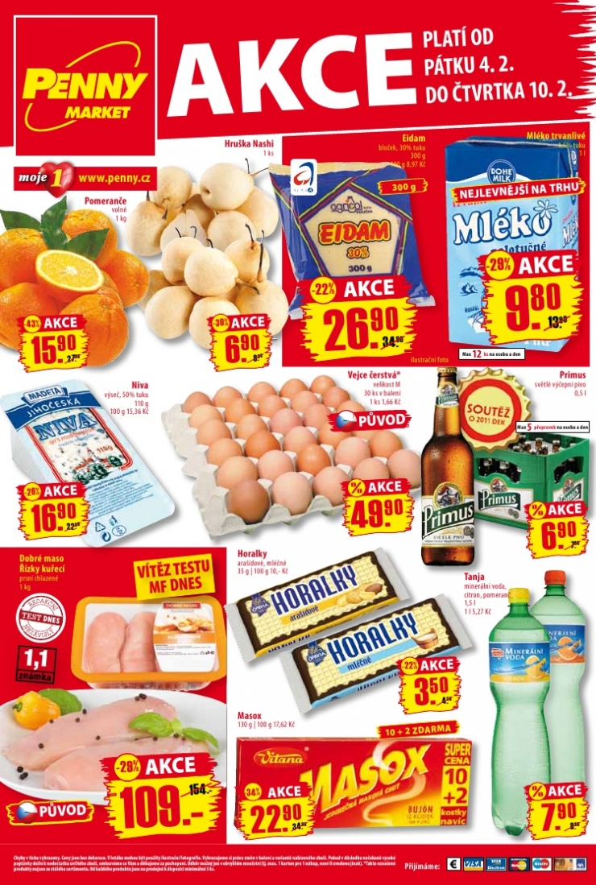

https://www.youtube.com/watch?v=m8FtTrDsTTc

Slide 17
Informative advertising
Some advertising mainly aims to associate certain positive feeling with a certain brand. Such advertising might fit the persuasive view of advertising.
However, advertising often also does contain information about
existence of a product
price of a product (e.g. sales...)
features of a product
Informative advertising can be pro-competitive and socially beneficial

Slide 18
Directly Informative advertising
Again Hotelling model of price competition with horizontally differentiated products
u = r – tx – p₁
Number of consumers normalised to 1
r sufficiently high so that everyone will buy if price set by monopolist
If all consumers knew about all products, the marginal consumer given by x* = 1/2 + (p₂ – p₁)/2
But now assume
only a fraction s_{i} of consumers know about the existence of firm i’s product
firms can increase s_{i} via advertising
advertising is not targeted so
Share s₁s₂ of consumers are aware of both firms
Share s₁(1-s₂) consumers are aware only of firm 1

Slide 19
Directly Informative advertising
3 types of consumers
Fully informed – decide who to buy from
Partially informed – buy from the firm they know about
Fully uninformed – do not buy
Firms simultaneously set advertisement and prices
Informing customers about the existence of firm costs as_{i}²/2

Slide 20
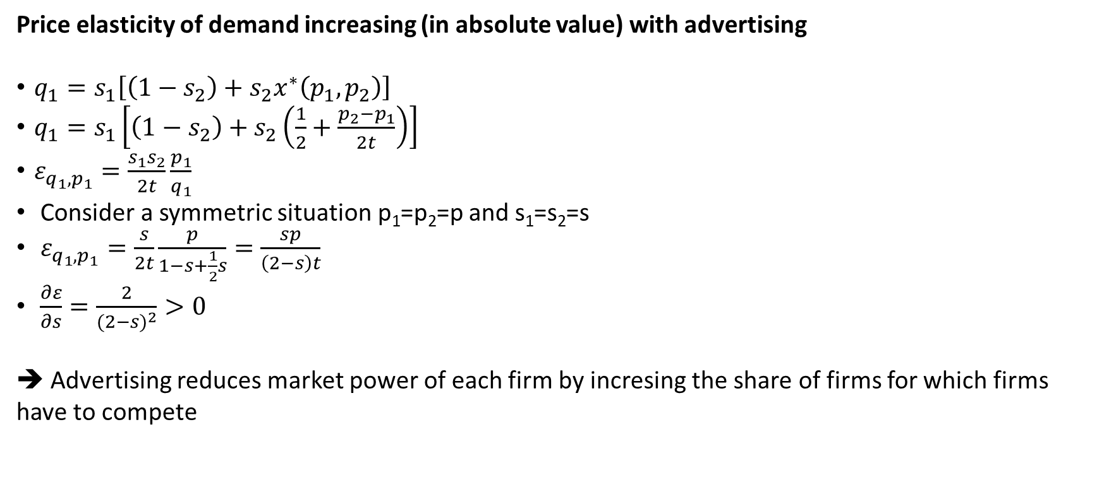
Directly informative advertising
Price elasticity of demand increasing (in absolute value) with advertising
$q_{1}=s_{1}\left[\left(1−s_{2}\right)+s_{2}x^{∗}\left(p_{1},p_{2}\right)\right]$
$q_{1}=s_{1}\left[\left(1−s_{2}\right)+s_{2}\left(\frac{1}{2}+\frac{p_{2}−p_{1}}{2t}\right)\right]$
$ε_{q_{1},p_{1}}=\frac{s_{1}s_{2}}{2t}\frac{p_{1}}{q_{1}}$
Consider a symmetric situation p₁=p₂=p and s₁=s₂=s
$ε_{q_{1},p_{1}}=\frac{s}{2t}\frac{p}{1−s+\frac{1}{2}s}=\frac{sp}{\left(2−s\right)t}$
$\frac{∂ε}{∂s}=\frac{2}{{(2−s)}^{2}}>0$
➔ Advertising reduces market power of each firm by incresing the share of firms for which firms have to compete

Slide 21
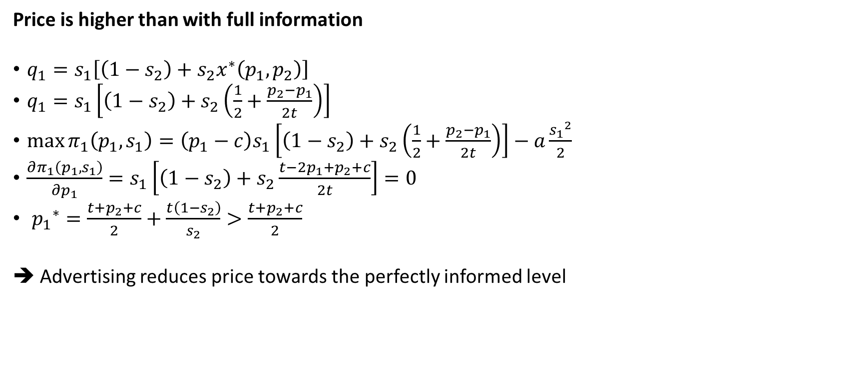
Directly informative advertising
Price is higher than with full information
$q_{1}=s_{1}\left[\left(1−s_{2}\right)+s_{2}x^{∗}\left(p_{1},p_{2}\right)\right]$
$q_{1}=s_{1}\left[\left(1−s_{2}\right)+s_{2}\left(\frac{1}{2}+\frac{p_{2}−p_{1}}{2t}\right)\right]$
$\max{π_{1}\left(p_{1},s_{1}\right)}=\left(p_{1}−c\right)s_{1}\left[\left(1−s_{2}\right)+s_{2}\left(\frac{1}{2}+\frac{p_{2}−p_{1}}{2t}\right)\right]−a\frac{{s_{1}}^{2}}{2}$
$\frac{∂π_{1}\left(p_{1},s_{1}\right)}{∂p_{1}}=s_{1}\left[\left(1−s_{2}\right)+s_{2}\frac{t−2p_{1}+p_{2}+c}{2t}\right]=0$
${p_{1}}^{∗}=\frac{t+p_{2}+c}{2}+\frac{t\left(1−s_{2}\right)}{s_{2}}>\frac{t+p_{2}+c}{2}$
➔ Advertising reduces price towards the perfectly informed level

Slide 22

Directly Informative advertising
Marginal cost of advertising equals profit margin times probability the extra consumer informed about firm 1 actually buys from firm 1
$\frac{∂π_{1}\left(p_{1},s_{1}\right)}{∂s_{1}}=\left(p_{1}−c\right)\left[\left(1−s_{2}\right)+s_{2}\left(\frac{1}{2}+\frac{p_{2}−p_{1}}{2t}\right)\right]−as_{1}=0$
${as_{1}}^{∗}=\left(p_{1}−c\right)$ $\left[\left(1−s_{2}\right)+s_{2}\left(\frac{p_{2}−p_{1}+t}{2t}\right)\right]$

Slide 23
Directly Informative advertising
Symmetric Nash equilibrium
p₁* = p₂* = c + (2at)^{1/2}
➔ If s=1 then p* = t + c as with full information
➔ Price increases with differentiation t and advertising costs a
s₁* = s₂* = 2 / (1 + (2a/t)^{1/2})
➔ Investment in advertising increases with differentiation t and decreases with advertising costs a
π₁* = π₂* = 2a / (1 + (2a/t)^{1/2})²
➔ Profits increase with differentiation t and with advertising costs a
Again, industry associations have an incentive to try to increase costs / ban advertising
Persuasive advert. affecting willing. to pay: to prevent wasteful zero-sum-game advertising
Here: to protect monopolies over only partially-informated consumers

Slide 24
Topic outline
Persuasive advertising
Direct informative advertising
Indirect informative advertising

Slide 25
Informative advertising (indirect)
Signalling = an action that the firm would not find profitable if it was low quality
Assume
One firm and one consumer
Firm produces
H with probability ½, consumer values as r
L with probability ½, consumer values as 0
Producer knows the quality but customer initially doesn’t
Two periods
Consumer does not know the quality of the product
Consumer knows the quality IFF they bought it in period 1
MC = c (independent of quality)
Firm can do warranties
But firm can also spend any amount A on non-informative advertising in period 1

Slide 26
Informative advertising (indirect)
Full information
High-quality firm sells at p = r in each period
Low-quality firm does not sell

Slide 27
Informative advertising (indirect)
Asymmetric information
If firm high-quality
Period 1:
p₁ = r
A = r – c – ε (where ε is a small amount)
π₁ = – ε (burning money to signal quality)
Period 2:
p₂ = r
π₂ = r – c
π = r – c – ε
If firm was low-quality but advertised, it would lose ε and earn nothing in period 2
➔ consumer believes firm setting p₁ = r and A = r – c – ε in period 1 is of high-quality

Slide 28
Informative advertising (indirect)
But a few problems with this model:
If low quality was associated with lower marginal cost, low-quality firms could imitate high-quality firms in Period 1, take the profits (thanks to their low costs) and run. This would destroy the equilibrium described above.
In the simple model above, p=r-ε would do the same job
Empirical evidence mixed – hard to measure asymmetric information
How is poor researcher to observe quality that customers don‘t obseve?
If the advertising expenditure itself is important, firms should announce their advertising expenditure. But they don’t.

Slide 29
Exercise: Advertising as a signal of quality
A firm produces a single product, which is of either high (H) or low (L) quality.
The firm knows the quality but consumers don‘t.
The firm sells the product in 2 periods.
In each period, N consumers with willingness to pay r_{H} = 10 and r_{L} = 5
Consumers only learn about product quality if they buy it in period 1
c_{H} = 4 and c_{L} = 3
The firm can advertise the product on TV in period 1. The cost of a TV ad is
A if quality is low
aA, a<1 if quality is high
The firm discounts future by δ
What is the minimum number of ads for a firm to show it is high quality?
How does the andswer depend on δ, a and N?

Slide 30

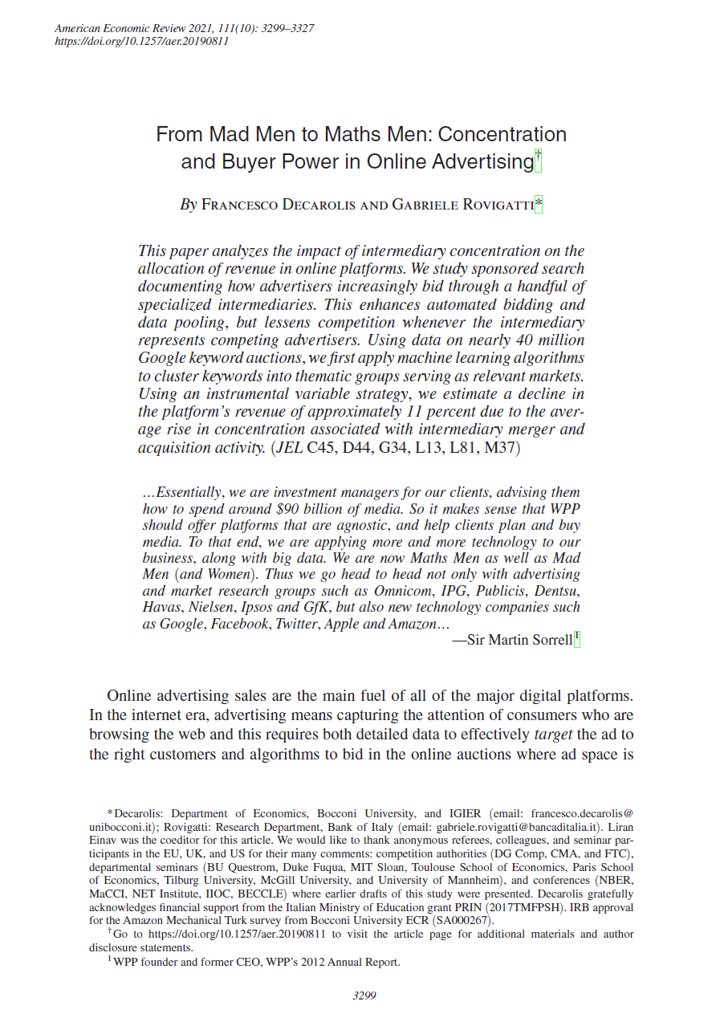
Intermediaries in online advertising
Targeted online advertising a key revenue source for many online platforms
But the key commodity – consumer attention – highly concentrated at a few platforms (Google search, Facebook…) and auctioned off to advertisers
At the same time, advertisers increasingly hire intermediaries to do the bidding on their behalf (about 75% of all search slots sold)
The intermediaries are themselves large and concentrated (CR4=70%)
Could buyer market power among the intermediaries counterveil the platform market power?
Decarolis and Rovigatti (2021) suggest it could

Slide 31

Downstream market power: A question
Double marginalisation vs. counterveiling market power:
Why is the former bad for consumers and the latter good?

Slide 32

What are the three economic views of advertising and how do they differ?
Why do business associations sometimes try to ban advertising?
Why do they sometimes support advertising
Is advertising good or bad for competition?
What questions do you have?

